Slide 1
SLM online course Univ.-Prof. Dr. Jörg Königstorfer
L E C T U R E Winter semester 2020/2021

Slide 2
How to Prepare for the Exam
How will the exam look like?
The exam takes 75 minutes.
The exam consists of 36 multiple choice questions: There are five possible answers, only one is correct.
In addition to these multiple choice questions, there are also open-end questions at the end of the exam (1-3 questions).
The questions can include calculations. (Please bring a calculator with you that cannot be programmed when taking the exam.)
The content of all lectures will be covered in the exam

Slide 3
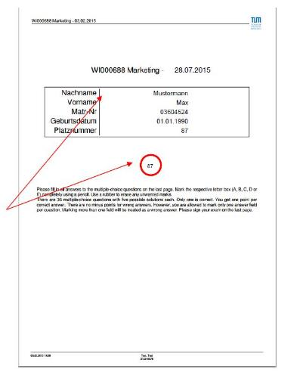
Dos and don’ts
About the exam
Personalized exam
Randomized questions & answers
Name, Matriculation number & Date of birth are automatically printed on cover & answer sheet
Before entering the room every student will be assigned to a seat number.
When arriving at your seat, please check immediately if the exam has your name printed on.

Slide 4
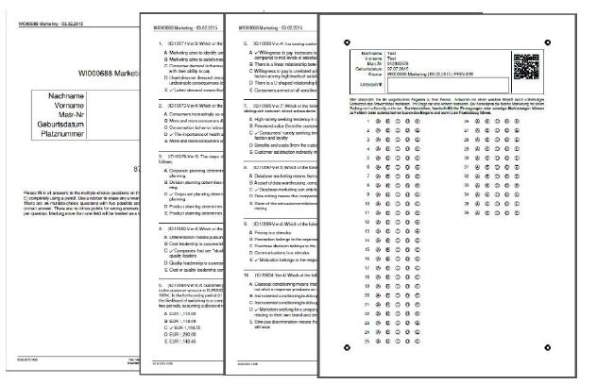
Dos and don’ts
Order of sheets
1 – Cover sheet
2 – Question sheets
3 – Answer sheet

Slide 5
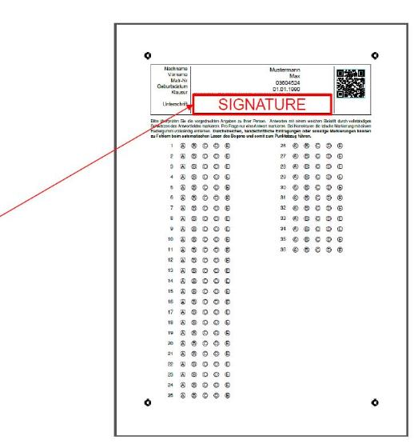
Dos and don’ts
Answer sheet
Before answering the exam questions:
MAKE SURE TO SIGN THE EXAM ON THE ANSWER SHEET (LAST PAGE)!
Otherwise your exam will not be valid !

Slide 6
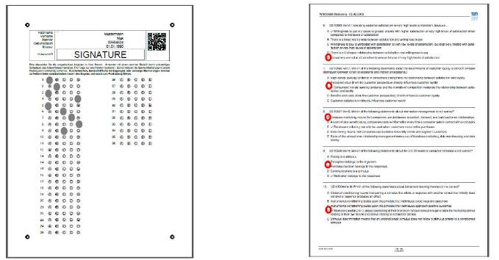
Dos and don’ts
Answer sheet
Mark your answers only on the answer sheet
DO NOT mark your answers on the question sheet
Answers on the question sheet will not be counted

Slide 7
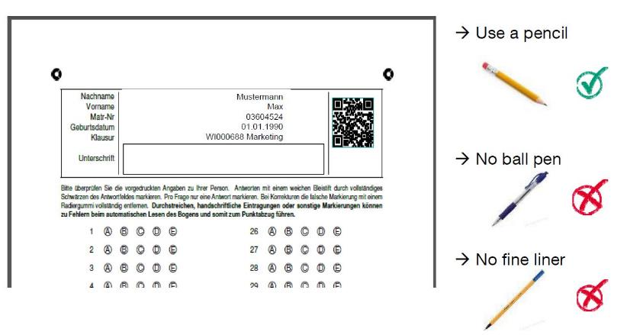
Dos and don’ts
Answer sheet

Slide 8
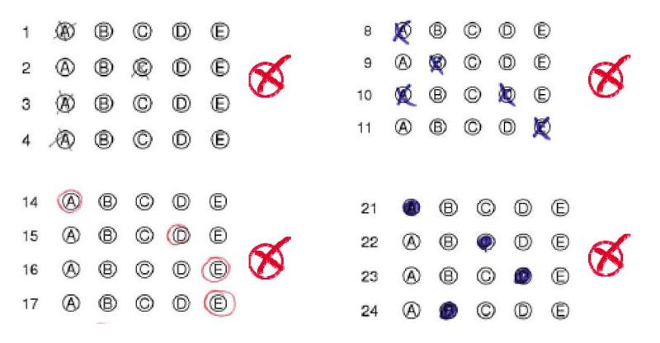
Dos and don’ts
Answer sheet

Slide 9
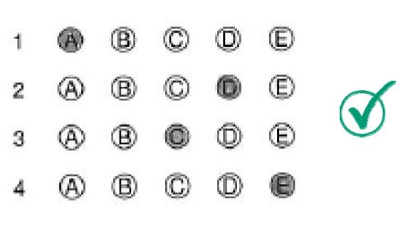
Dos and don’ts
Answer sheet
Use a pencil and completely mark the respective the correct letter box!

Slide 10
Dos and don’ts
Advices
Make sure your sign the exam on the last page (= answer sheet)
Make sure you have answered EVERY question on the ANSWER SHEET (There are no minus points for wrong answers!)
Make sure you marked the answer sheet correctly

Slide 11
Dos and don’ts
What to bring
Pencil
Rubber
Dictionary (without any comments and markings)
Calculator (non-programmable)

Slide 12
Sample question

Slide 13
Q1. The fit between the sponsor and the sponsored entity can indicate similarities in:
Mission
Products and services
Technology
Associations
Markets
1, 2, 3 and 4 are correct only
1, 2, 3 and 5 are correct only
2, 3, 4 and 5 are correct only
2, 3 and 4 are correct only
All are correct

